Slide 1



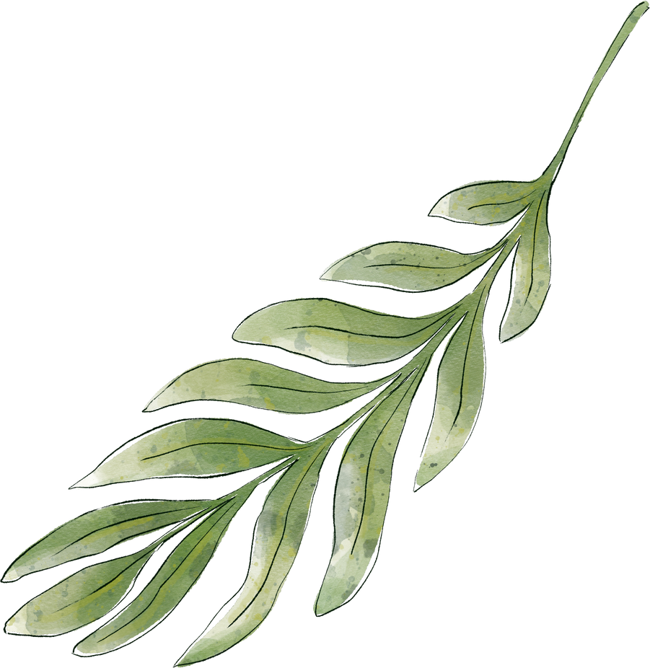
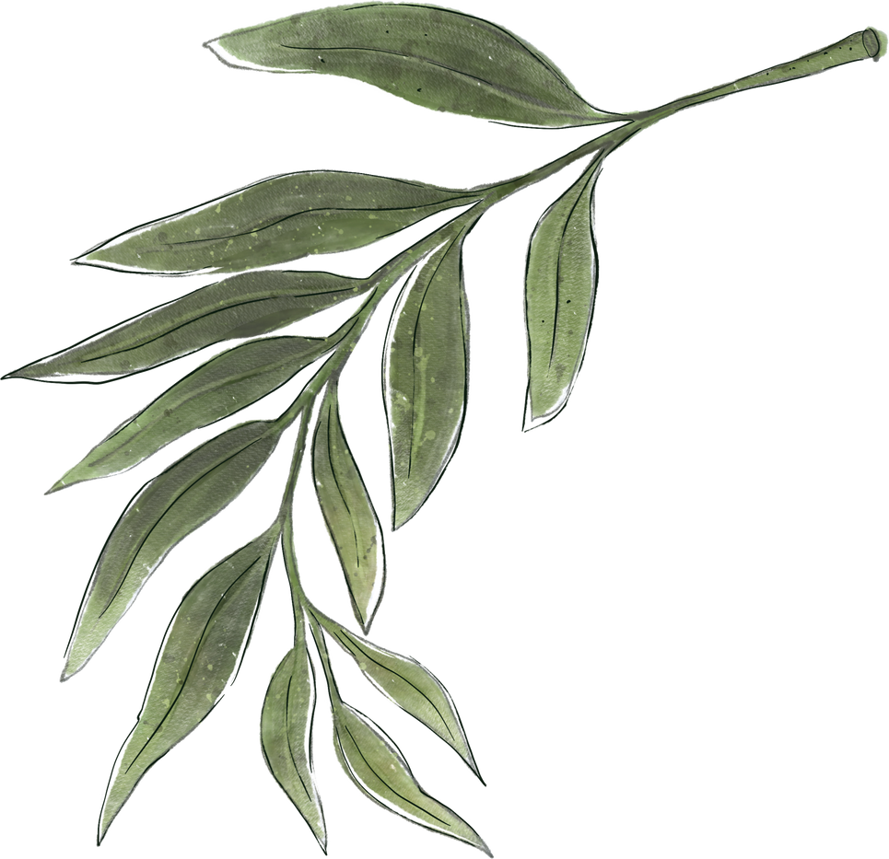

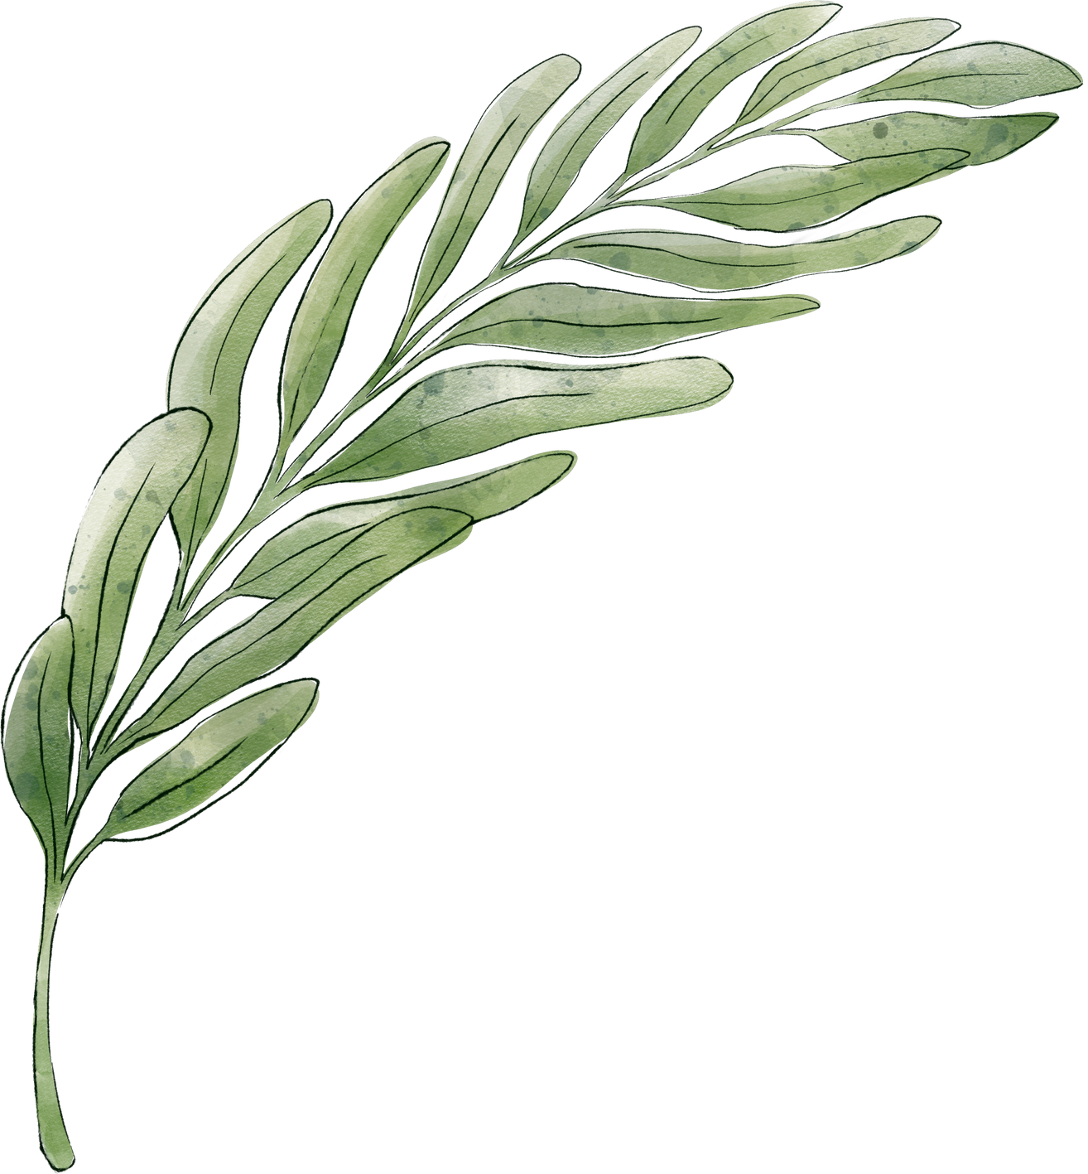
Behind the Model
Methodology, Optimization & Evaluation
~By Smira Jaitley

Slide 2
Project Goals
1.
Build a kNN-based classification model which predicts whether a molecule is mutagenic or not.
2.
Optimize the hyperparameter k using techniques like cross-validation and evaluate the model using the F1-score to balance precision and recall.

Slide 3
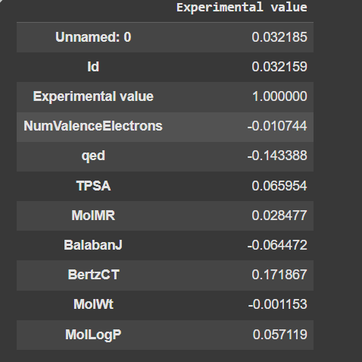
Initial Observations
On observing the dataset, we see that it contains some non numeric columns like ‘CAS’ , ‘SMILES’ and ‘Training’. To be able to check the correlation of the features with the target variable, I created a dataset with only numeric columns.
I checked the correlation values and removed the features with very low correlation values or unnecessary columns like ‘Id’, ‘Unnamed: 0’ & ‘MolWt’.
Correlation values

Slide 4
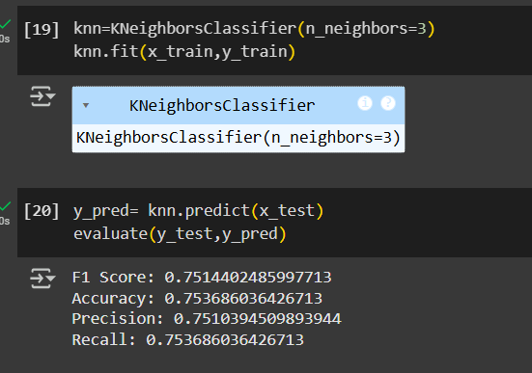
Methodology
Now, I separated the columns into x(features) and y(target variable). My target variable was ‘Experimental Value’ which was binary( 1- Mutagenic, 0- Non-mutagenic).
I used StandardScaler to scale the features and split them into training and testing datasets with test_size=0.2.
Then, I created the knn model and evaluated the prediction through metric like f1 score, accuracy, precision and recall.

Slide 5
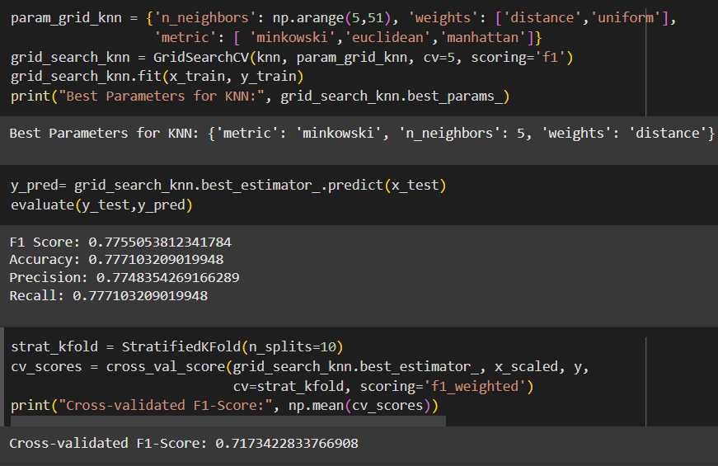
Hyperparameter Tuning
Here we have used GridSearchCV to search for the optimal kNN parameters by evaluating different values for n_neighbors, weights, and metric.
cv=5: Uses 5-fold cross-validation to evaluate each parameter combination.
scoring='f1': Optimizes for the F1-score, which balances precision and recall.

Slide 6
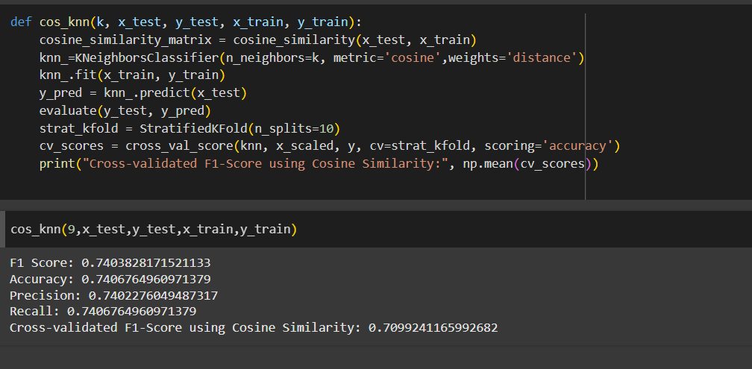
Cosine Similiarity Model
Euclidean Distance is affected by the magnitude of features, meaning features with larger values can dominate distance calculations.
Cosine Similarity focuses on the angle between feature vectors rather than magnitude, making it better for high-dimensional and sparse data (e.g., text data, molecular descriptors like our mutagenicity model).

Slide 7
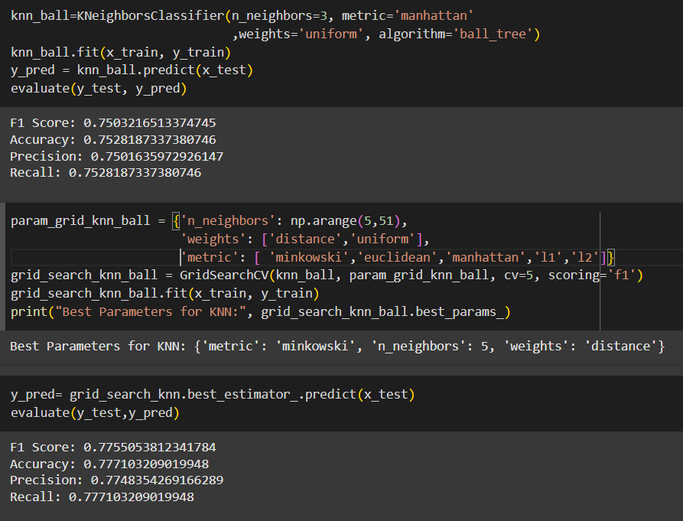
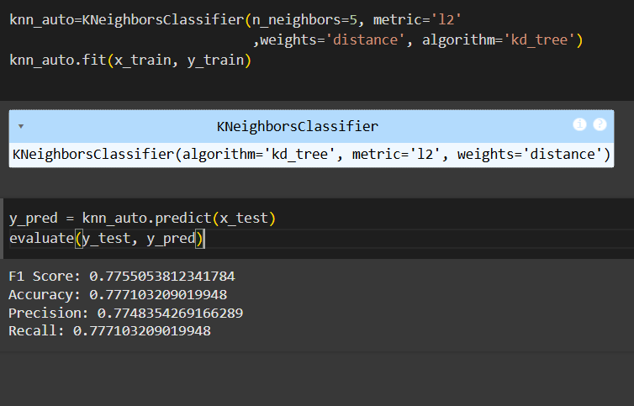
Other Algorithms
Ball-Tree Algorithm
KD-Tree Algorithm

Slide 8
Evaluation
The best results are achieved by the hyperparameter tuning of the knn model and by the ball-tree model
F1 Score- 77.55%
Accuracy- 77.71%
Precision-77.48%
Recall-77.77%

Slide 9
Thank You

